Slide 1
Sprint retrospective
Team 4

Slide 2
PROCESS

Slide 3
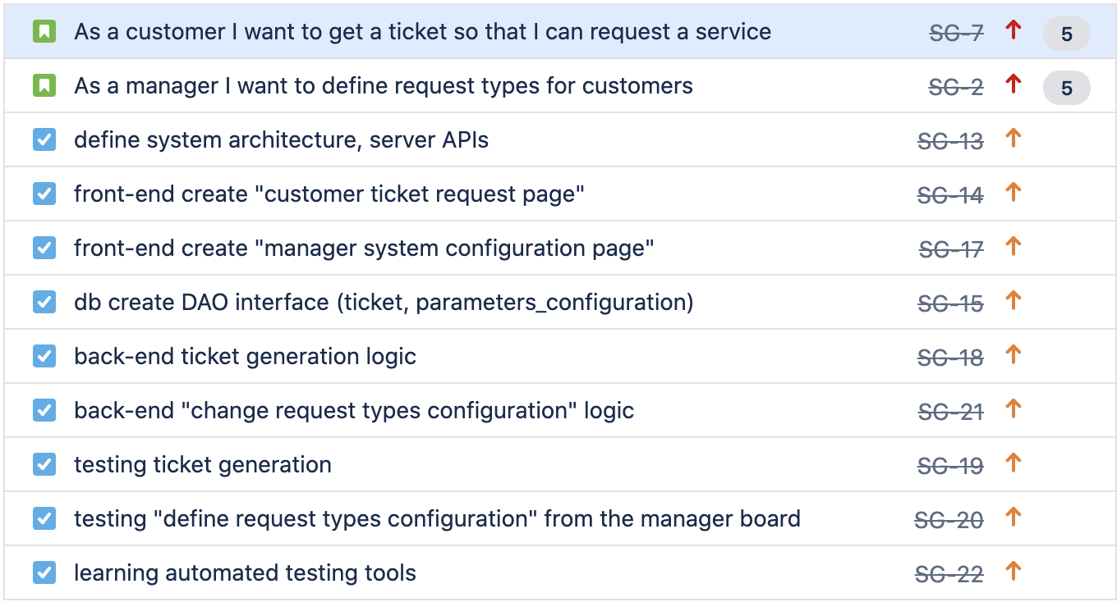
OVERVIEW - our stories and tasks

Slide 4
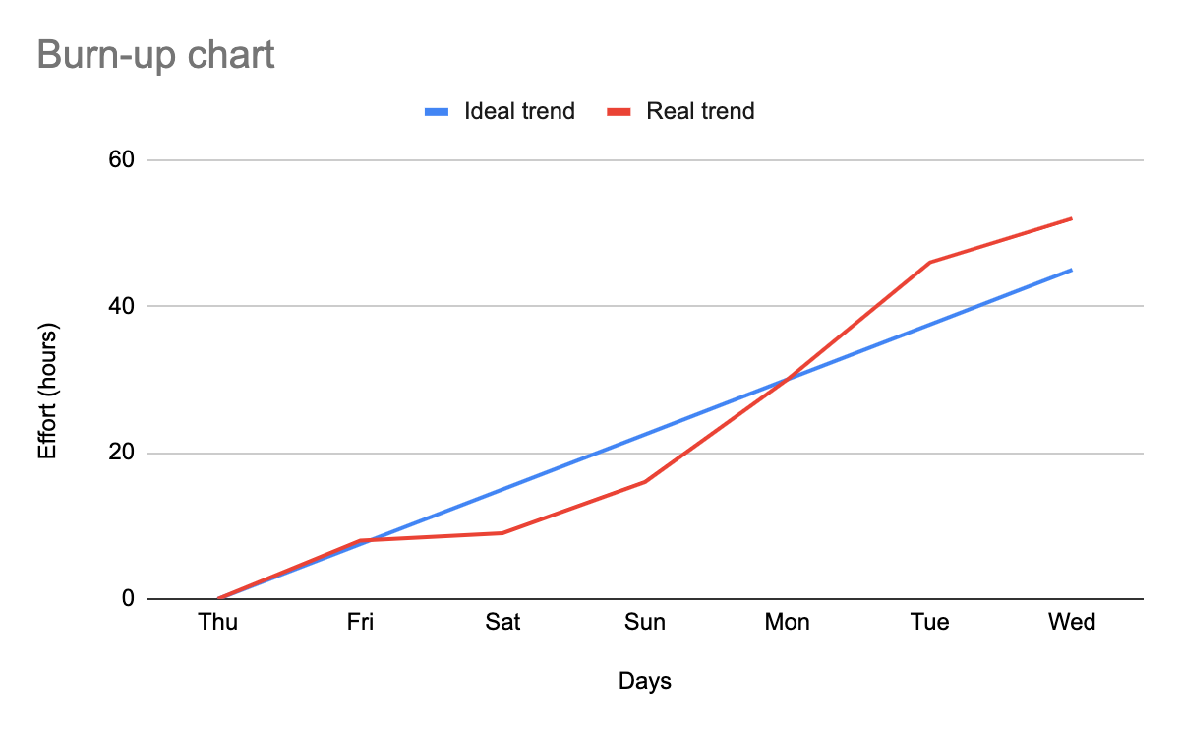
MACRO STATISTICS
Stories committed: 2 Stories done: 2
Total points committed: 10 Total points done: 10
Hours planned: 45 Hours spent: 52

Slide 5
DETAILED STATISTICS
ID story | Points | Task ID | Total hours estimated | Total hours spent
SG-2 | 5 | - | 13.5 | 19.25
 |  | SG-15 * | 3 | 3.75
 |  | SG-17 | 3 | 8
 |  | SG-20 | 6 | 5.5
 |  | SG-21 | 1.5 | 2.5
SG-7 | 5 | - | 13.5 | 14.75
 |  | SG-14 | 3 | 3.5
 |  | SG-15 * | 3 | 3.75
 |  | SG-18 | 1.5 | 3.5
 |  | SG-19 | 6 | 4.5
none | - | - | 18 | 17
 |  | SG-13 | 12 | 8
 |  | SG-22 | 6 | 9
total | 10 | - | 45 | 52
Average:
5.78 hours/task
Standard deviation:
2.40 hours/task
Total task estimation error ratio:
0.86
(tot hours estimated / tot hours)
* horizontal task

Slide 6
ESTIMATION ERRORS
SG-15: * underestimated the work/time needed to lay down the database system;
SG-17: * a lot of more time was needed to review on "how to do things" in React; * the workload related to this task was bigger than expected;
SG-18: * more time was needed to review the inner workings of express;

Slide 7
ESTIMATION ERRORS
SG-19: * estimation took in account all the group members while in practice only a few of them were tasked to do the job;
SG-22: * lack of technical knowledge about testing frameworks caused the team members to spend a lot of time in the learning phase;

Slide 8
QUALITY

Slide 9
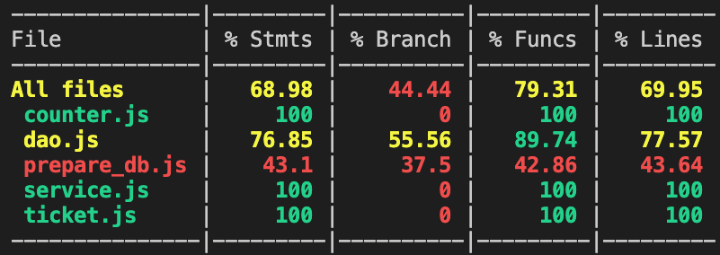
UNIT TESTING
DAO MODULE:
Total hours estimated: 12 Total hours spent: 13 Number of automated tests: 14
Coverage:
information from nyc and mocha

Slide 10
SYSTEM TESTING
API testing (with postman):
Total hours estimated: 6 Total hours spent: 6 Number of tests: 10

Slide 11
CODE REVIEW
Total hours estimated: not estimated Total hours spent: 3
The code review has been necessary to understand more in deep other teammates' code and integrate tasks.

Slide 12
ASSESSMENT

Slide 13
LESSONS LEARNED
POSITIVE
Dedicate part of the allocated time to system design it proved to be good choice
Dividing the team in smaller groups per task lead to a higher productivity
NEGATIVE
It is better to overestimate than underestimate the amount of work
Once an interface has been defined, it must not be changed it prior a discussion with the other team members (or at least the people affected by it)

Slide 14
IMPROVEMENTS
Discuss before making any breaking changes with your teammates (or at least the people affected by it)
Reflect more in depth about the workload needed by a task. It is better to divide a task in subtasks if the estimation it is not clear or well defined.
Define a coherent and a systematic approach for managing the project folder structure

Slide 15
FINAL THOUGHTS
As a team, we are proud on how well we adapted to unforeseen challenges as we progressively developed our system.
Finally, we are happy that we managed to complete all the stories that we have selected.

Slide 16
Practice is harder than theory

